Slide 1
The Irlen Institute has helped over a million people worldwide through its comprehensive diagnostic process and innovative color filtering technology. Backed by over 35 years of scientific research, the Irlen Method’s proprietary technology filters out specific wavelengths of light to alleviate stress on the brain and allow it to process visual information correctly.
WHO CAN BE HELPED
IRLEN QUICK FACTS
Servicemen and woman who have experienced concussions and traumatic brain injury from blast exposure may be helped by Irlen Spectral Filters if they experience any of the following:
EXTREME PHOTO SENSITIVITY (i.e., sensitivity to bright lights, sunlight, or fluorescent lights)
CHRONIC HEADACHES OR MIGRAINES that are not relieved by other courses of treatment and do not respond to medication
HAVE HAD CHANGES IN PERFORMANCE and their ability to function in daily life and on the job
DIFFICULTY WITH READING, computers, tablets, and/or smartphone use
CHANGES IN DEPTH PERCEPTION
Irlen treats a perceptual processing disorder caused by the brain's inability to process specific wavelengths of light.
Irlen can help an estimated 55% with head injury, concussion or whiplash.
Irlen Spectral Filters® are individualized, precision-tinted lenses that filter out the offensive wavelengths of light, allowing the brain to process visual information correctly.
The Irlen Method has helped more than 1,000,000 people around the world.
The Irlen Method and the efficacy of colored overlays and colored lenses has been the subject of over 200 research studies encompassing the disciplines of education, psychology, and medicine.
RESEARCH


Since 2011, Irlen has partnered with Semper Fi Fund to provide Irlen Spectral Filters to servicemen and women experiencing “medically resistant” headaches and migraines as a result of combat-related concussion or brain trauma. A study of 178 of these servicemen and woman showed immediate and dramatic improvements of headaches and migraines, as well as a variety of other areas, including reading, night driving, eye-strain, and dizziness. Results from this study were presented at the World Congress on Brain Injury held in San Francisco, CA in March 2014.
In general life has gotten easier, better, and less painful.” – Bradley Pierson
The changes are miraculous. He has made more improvements in the past month with his Irlen Filters than he has made in the past 4 years.” – Wife of SSgt. George Hill
FOR MORE INFORMATION
For more information about Irlen Syndrome, The Irlen Method, and use of precision-tinted spectral filters to address headaches and migraines after brain injury, visit www.irlen.com or email sandy@irlen.com.

Slide 2
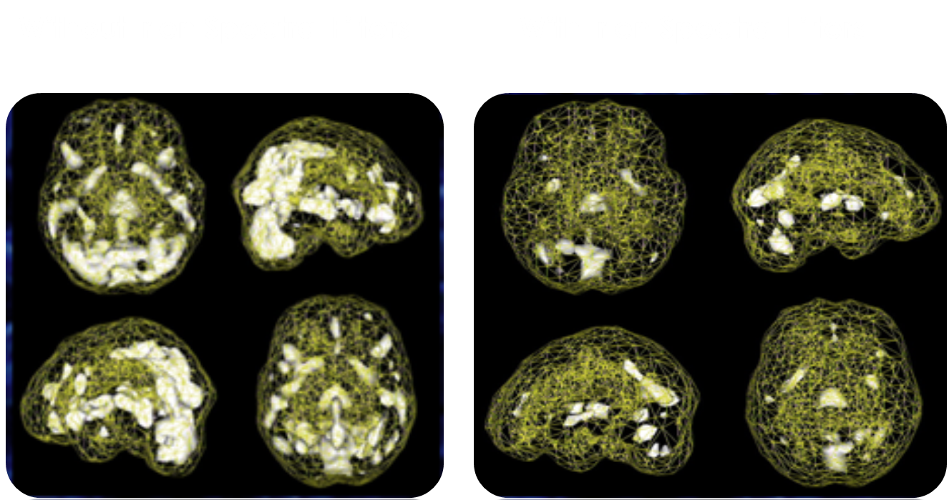
The Effect of Spectral Filters on Brain Function
SPECT Scans courtesy of the Amen Clinic
Visually intensive activities cause over-activity in the brains of individuals with Irlen Syndrome. When these individuals wear their Irlen Spectral Filters, the brain calms down and brain function normalizes.
Light and the Brain, Daniel Amen, MD
In one study by Amen and colleagues, comparing the brains of 42 people with Irlen syndrome to 200 age-matched individuals without any evidence of Irlen syndrome, SPECT scans showed increased activity in the brain’s emotional and visual processing centers and decreased activity in the cerebellum (an area that helps to integrate coordination and new information).
fMRI Evidence that Precision Ophthalmic Tints Reduce Cortical Hyperactivation in Migraine
Huang, J., Zong, X., Wilkins, A., Jenkins, B., Bozoki, A., Cao, Y. (2011). Cephalagia, 31(8):925-36.
Huang et al. (2011) used fMRI to investigate differences between individuals suffering visual stress and controls in relation to migraine and to determine the effectiveness of precision-tinted colored filters for individuals suffering from visual stress. The research showed a normalization of cortical activation and spatial frequency tuning in the migraineurs by precision tinted filters that suggests a neurological basis for the therapeutic effect of these lenses in reducing visual cortical hyperactivation in migraine.
www.irlen.com
5380 Village Road, Long Beach, CA 90808

Slide 3
A successful intervention for medically-resistant headaches and migraines after brain injury
SANDRA TOSTA, PHD AND HELEN IRLEN, MFT, JEFFREY LEWINE, PHD, JOSHEPH ANNIBALI, MD
Methods
178 U.S. military personnel
Have already tried one or more treatments: migraine medication, other medication, acupuncture, chiropractic treatments, healing touch, yoga, meditation, vestibular therapy, Botox, hyperbaric, alpha stem.
Data regarding headache and migraine frequency and medication use were analyzed using paired-samples t-tests. All comparisons were highly significant (p=.00). Likert scale data related to physical symptoms and activities causing difficulties were analyzed using multiple analysis of variance (MANOVA) with Bonferroni correction. The multivariate and all univariate analyses were highly significant (p=.00).
Areas of Inquiry
Frequency/severity of headaches/ migraines, light sensitivity, academic difficulties, physical symptoms, emotional symptoms, depth perception, driving.
Introduction
Precision-tinted spectral filters remedy perceptual difficulties and physical symptoms (including headaches and migraines) associated with the perceptual processing disorder, Irlen Syndrome. Advanced brain-mapping technology shows both anatomical and functional changes in brain activity that correspond directly with a reduction of symptoms when the correct color is worn as glasses. In March 2011, Irlen partnered with Semper Fi Fund to provide Irlen Spectral Filters to military personnel experiencing “medically resistant” headaches and migraines as a result of combat-related brain or head trauma.
Objective
Extend the current therapeutic use of precision-tinted spectral filters to individuals who have acquired headaches and migraines as a result of head injury or brain trauma.
Conclusion
For military personnel experiencing debilitating headaches and migraines that fail to respond to other interventions, Irlen Spectral Filters provide immediate relief and improvements. These improvements extend beyond headaches and migraines to impact other areas of life and daily functioning that are crucial to both their ability to remain in active duty and to achieve success after retiring from the military. Irlen Spectral Filters are able to eliminate the pain and discomfort that other interventions or medication have not been able to eliminate, provide stability and clarity in the visual field, and improve physical, emotional, and academic functioning. Future research should utilize brain imaging to document the reported improvements as functional and/or anatomical changes in the brain.
Injury
Diagnosis
Assessment #1
Intervention
Assessment #2
Combat-related TBI/Concussion
Medically-resistant headaches and migraines
Referred to Irlen for spectral filters
Pre questionnaire assessment of difficulties (0-5 scale)
Wear spectral filters for 1 to 3 months
Post questionnaire
Results
Avg. number of migraines per month
RX doses per month
Percent of the day headaches are experienced (avg.)
OTC doses per month
SEVERITY OF DIFFICULTY BEFORE AND AFTER
Average rating of difficulty (0-5 scale, 0 means “no problem” and 5 means “severe problem”)
Light Sensitivity
Driving/ Night Driving
Eyestrain
Depth Perception
Reading
Nausea
Pre
4.75
3.81
4.01
2.71
4.8
2.41
Post
0.10
0.10
0.17
0.11
0.28
0.18
Pct. decrease
98%
98%
96%
96%
94%
93%
Headaches
Migraines
Dizziness
Anxious
Fatigue
Pre
4.54
4.51
3.21
4.13
4.42
Post
0.40
0.46
0.31
1.84
2.03
Pct. decrease
91%
90%
90%
55%
54%
References
Lewine, J.D., Irlen, H.L., & Orrison, W.W. (1996). Visual evoked magnetic fields in Scotopic sensitivity syndrome. (Available from New Mexico Institute of Neuroimaging. New Mexico Regional Field Medical Center: Albuquerque, NM).
Acknowledgements
Chouinard, B.D., Zhou, C.I., Hrybouski, S., Kim, E.S., Cummine, J. (2012). A functional neuroimaging case study of Meares-Irlen sydrome/visual stress (MISViS) Brain Topography, 25 (3), 293-307.
Huang, J., Zong, X., Wilkins, A., Jenkins, B., Bozoki, A., Cao, Y. (2011). fMRI evidence that precision opthalmic tints reduce cortical hyperactivation in migraine. Cephalagia, 31(8), 925-36.
Riddell, P.M., Wilkins, A., and Hainline, L. (2006). The effect of colored lenses on the visual evoked response in children with visual stress. Optometry and Vision Science, 83(5), 299-305.
This work was supported in part by the Semper Fi Foundation. Special thanks to Mauricio Ferreira, PhD, Eugene Oh, and the Hypothesis Group for their analytic contribution.
Research presented at the International Brain Injury Association 10th World Congress on Brain Injury, San Francisco, CA, March 2014
www.irlen.com
Sandra Tosta, PhD | sandy@irlen.com | 5380 Village Road, Long Beach, CA 90808 | 562-496-2550

